Slide 1

Our price offer: A07616000_A
Automatic production line for wire processing
17.06.2025
A07616000_A for Lisa Dräxlmaier / Satu Mare
Contact person Gluth:
Contact person Dräxlmaier:
Florian Schötz
Technical sales
E-Mail: schoetz.florian@gluth.eu
Tel : +49 9421 / 544-965
Mobil : +49 151 / 20832983
Radlbeck Ulrich
Technical sales
E-Mail: radlbeck.ulrich@gluth.eu
Tel: +49 9421 / 544-56
Mobil: +49 171 / 9493494
Thomas Eglseder
Purchase
E-Mail: Thomas.eglseder@draexlmaier.com
Tel : +49 8741 / 47 3574
Mobil : +49 152 / 2800 4115
Juhasz Levente
Engineering
E-Mail: Levente-istvan.juhasz@draexlmaier.com
Tel : +40 723 / 100 146
Mobil :

Slide 2
Table of contents
Basics
Task Description
Layout/Concept
Description of stations
Control System
Performance Criteria
Scope of Delivery
Supplies
Miscellaneous
Project Schedule
Project Prices

Slide 3
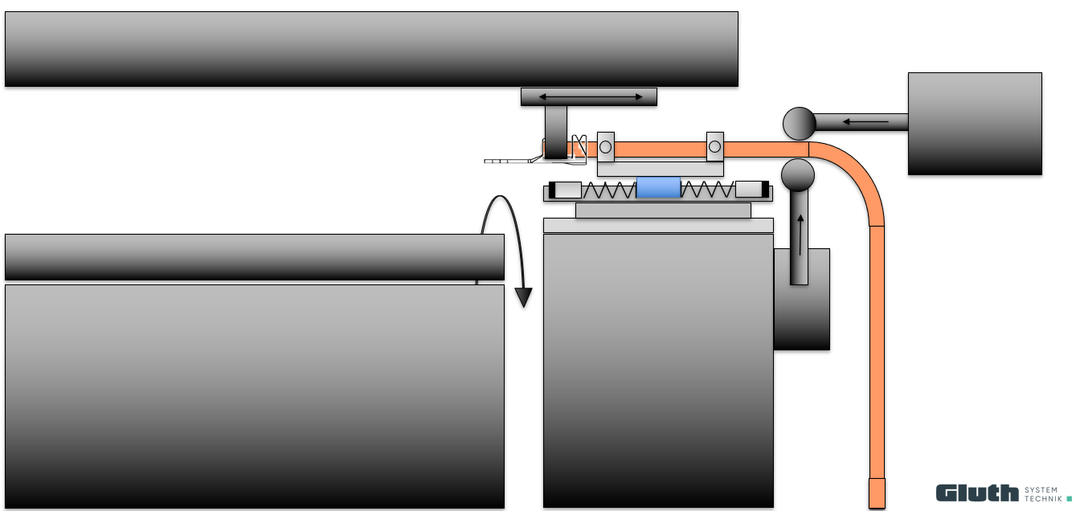
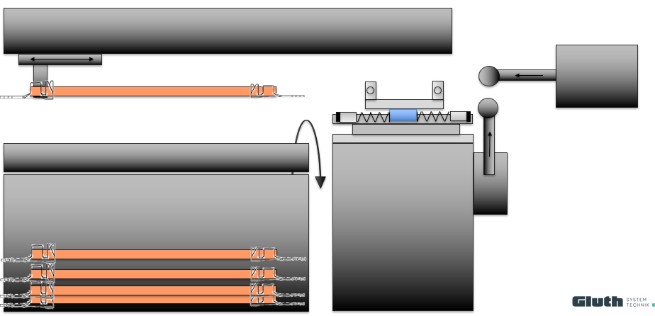
Output Cable
Station consisting of:
Support unit cable
  2x roller guide units pneumatically delivered
  Pull unit
  Electric pull axis
  Pneumatic gripper
  Universal Gripper fingers for all cable types
  Axis frame
  Opener Unit for WPC
  2x pneumatic cylinders to open the gripper jaws on the WPC
  Turnout OK-NOK
  Catch Tray OK
  Catch Tray NOK
  Base frame

